Slide 1
HADOOP
Hadoop Map Reduce

Slide 2
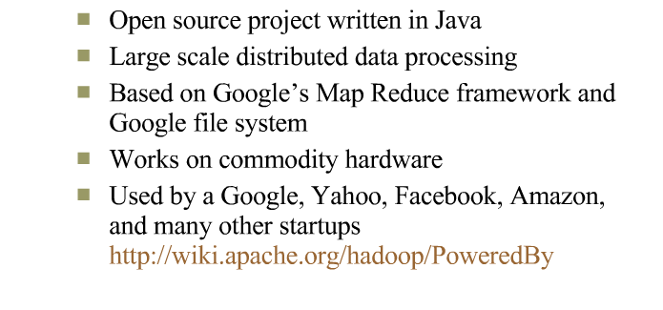
Introduction

Slide 3
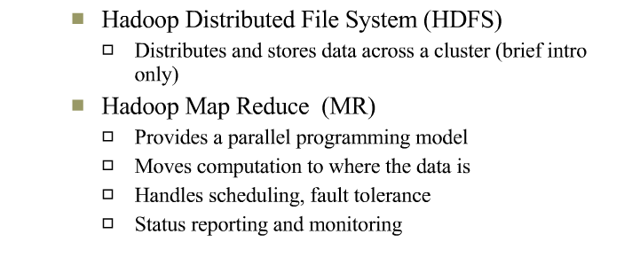
Hadoop Core

Slide 4

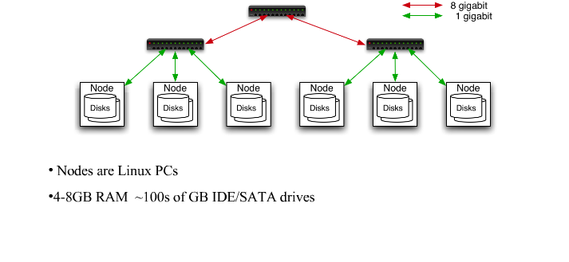
Typical Cluster

Slide 5
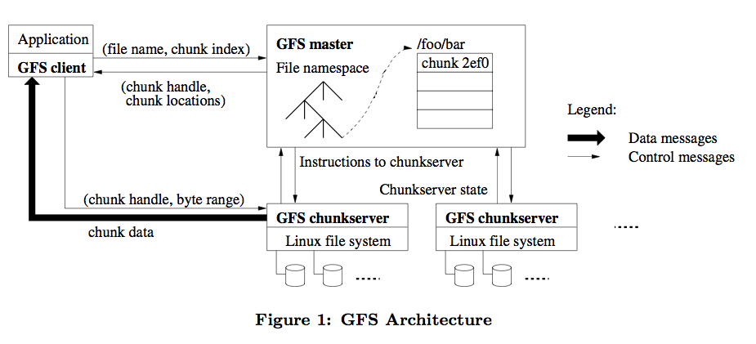
GFS

Slide 6
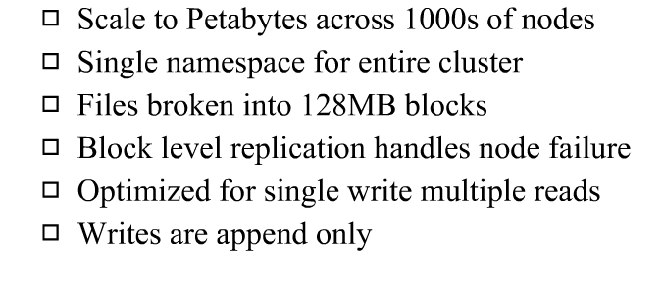
HADOOP Distributed File System

Slide 7
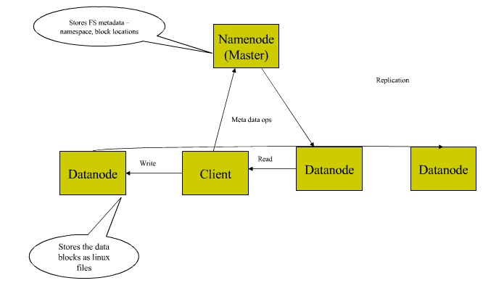
HDFS Architecture

Slide 8
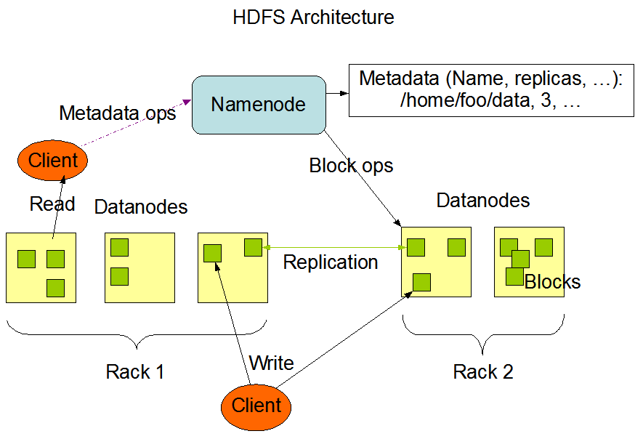
Hadoop Architecture

Slide 9



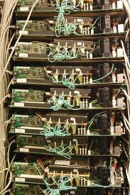

Slide 10
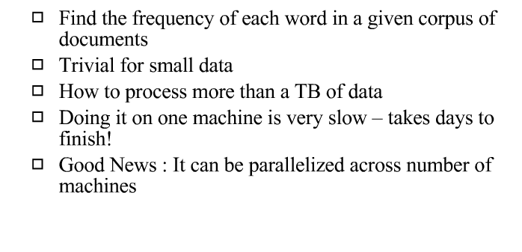
Word Count Problem

Slide 11
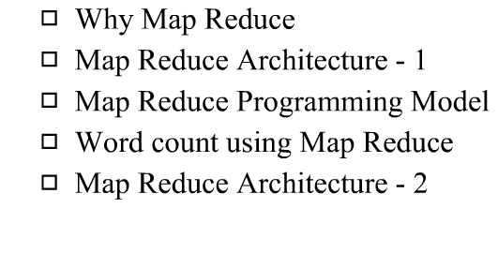
Hadoop Map Reduce

Slide 12
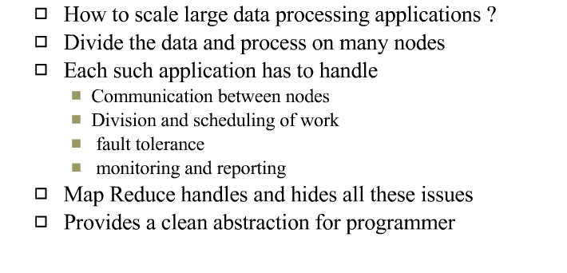
Why Map Reduce

Slide 13
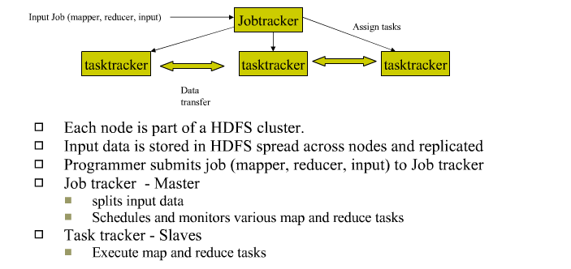
Map Reduce Architecture

Slide 14
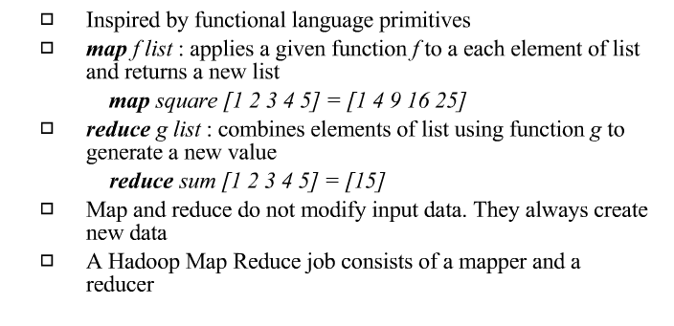
Map Reduce Programming Model

Slide 15
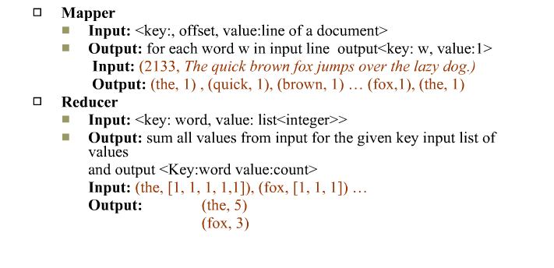
Map Reduce Programming Model

Slide 16
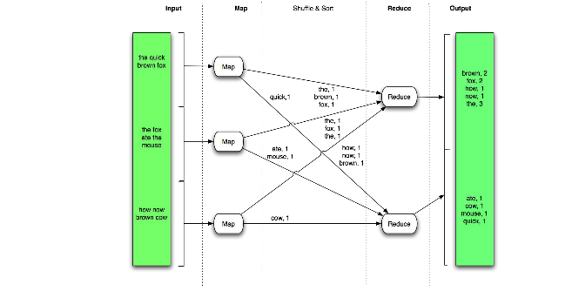
Word Count using Map Reduce

Slide 17
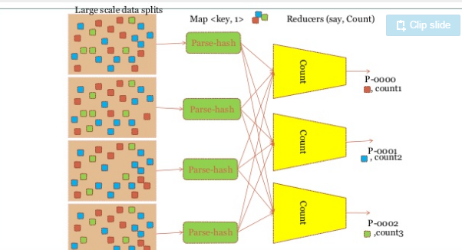
Map Reduce

Slide 18
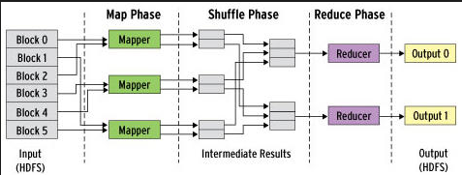
Map Reduce

Slide 19
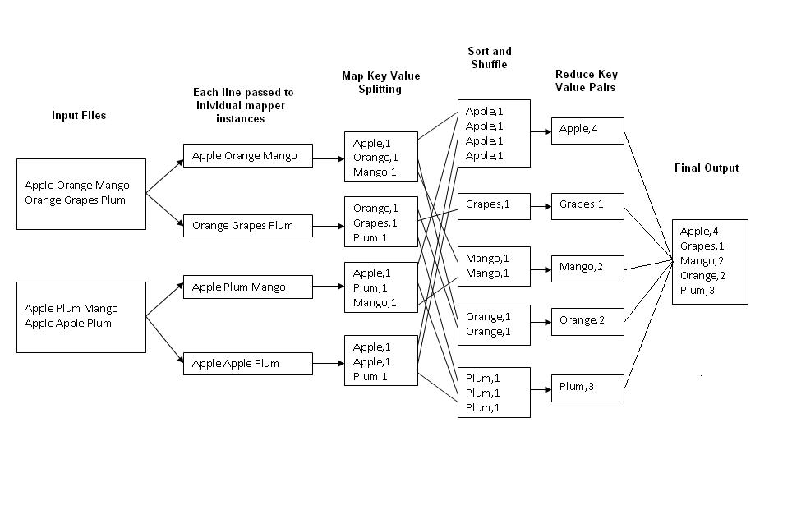
Example: Word Count
http://kickstarthadoop.blogspot.ca/2011/04/word-count-hadoop-map-reduce-example.html

Slide 20
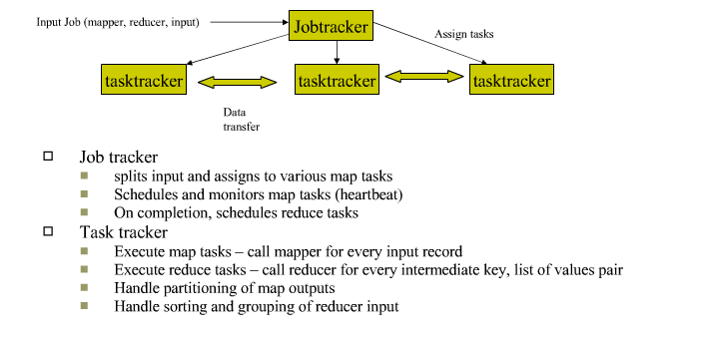
Map Reduce Architecture -2

Slide 21
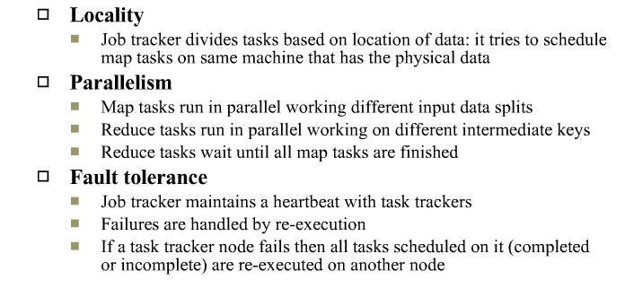
Map Reduce Advantages

